Slide 1
Online Car Dealer System
Group Members:
Rogelio Alonso
Ariel Cambas
Johann Henao
Yang Zhang

Slide 2
Brief Introduction
Our client "Sunshine Car Dealer Inc." is in the business of selling cars. They want to extend their business model to include an online car sales system that they wish to call "Sunshine Online Car Dealer System".
The purpose of having an online car dealer system for Sunshine Car Dealer are as follows:
Stay competitive
Different purchasing experience
Cut down expenses
Consolidate Inventory

Slide 3
Nonfunctional requirements
Definition:
The Sunshine Online Car Dealer System will sell vehicles online to user.
The sell process will occurred unattended from human supervision until car is ready to be shipped.
Usability
The Sunshine Online Car Dealer System will be available at all times and accessible from any computer connected to the internet with a browser.
Reliability
The system will be a secure reliable source to make a vehicle purchase.
The Sunshine Online Car Dealer System will not have an invalid input as all the input option will be provided for their selection.
The Sunshine Online Car Dealer System will only provide for sale whatever is available in it’s inventory.
Performance
There is no constrain on response time.
Supportability
Very portable since every device (i.e.: Smartphone or Tablet) with a browser will be able to access the Sunshine Online Car Dealer System .
The Sunshine Online Car Dealer System has been designed with Entity, Boundary and Control objects making the system more adaptable to maintainability, changes and support.

Slide 4
Functional Requirements
1- A Home page
a- Function to search
Make, Model, Year, Price Range , Mileage Range, Condition(New/Used).
b- Function to route user to register/login.
2- A Search Results Page
a- List of cars with basic car information Year, Model, Condition, Make, Model, Price, Mileage,
b- A detailed selected car information page with pictures of the car. Will show all of the basic information as well as pictures and additional notes.
c- Button to select car and continue to purchase.
d- If user is not logged in, the user will be taken to register/login page. Car selection must be saved in the user session so that once logged in/registered the user can see the car selected previously.
3- A Login page
Fields to enter User Name and password. Links to forgot username/password and to register.
Note: Both regular users or site administrator users can log in through this page.
4- A Registration page
Fields: first name, last name, date of birth, phone, billing address, shipping address, email,
user name, password, password confirmation.
5- A purchase page
Car details information, Car price, Delivery charges, taxes, grand total, Shipping Address, Payment information(Card holder's full Name, Card type, Card Number, Expiration Date, CVV code, Billing address.), confirmation/cancel buttons.
6- A Payment confirmation Page.
Car detail information, Total amount paid, receipt number, delivery date, delivery address.
7- A customer profile page
Customer details, change password option, option to update customer details information.

Slide 5
Functional Requirements
8- Logged in Admin home page
Buttons: Add Admin user, Registered Users, Car Inventory, Reports.
9-Add Admin page
Fields: first name, last name, description, active/inactive. Password, password confirmation.
10- Registered User page
List of all users, user name, first name, last name, type of user, buttons to delete or update selected user.
11- Car Inventory
Displays list of all available inventory (Sorted by make, model, condition). Option to
update/delete selected inventory item. Option to add a new car to inventory.
12- Add Car inventory page
Fields: Car details, car pictures path.
13- Reports page
Option to print Sales made current day, week, current month, current year, date range.
Definitions:
Car Details: Includes all of the following fields: Make, Model, Year, Condition, Mileage, Price, Color, Car item Number(car id).
Customer Details: Includes all of the following fields: User Name, First Name, Last Name, Billing/Shipping address, email address, Date of Birth.
Global page features: Back to home button, Logo of the company (On the upper right hand corner of page) and option to update the profile of a logged in user.

Slide 6
Constraints
Client Constraints:
The systems interface must be any web browser.
Sunshine Online Car Dealer System must contain a mySQL database with at least one user as Administrator.
It must assign a session to every user accessing a domain web page.
It has to be capable to support three types of user (Guest, Customer & Admin)
The Sunshine Online Car Dealer System has to sell cars with minimal human supervision.
The system sells 1 car at a time per user transaction.

Slide 7
Selected Use Case 1
Name: Login
Actor: User/Admin
Entry Condition:
User/Admin must be at the login web page of Sunshine Online Car Dealer System.
User/Admin has a valid username and password.
Event Flow:
User/Admin input username and password into the Login web page.
Sunshine Online Car Dealer System match username/password entered with list of stored users/admin.
Sunshine Online Car Dealer System logs User/Admin into the system.
User/Admin are redirected to home/index web page or into the requested page showing a logged in status.
Exit Condition: User/Admin is logged into Sunshine Online Car Dealer System.
Exceptions:
Cancel
“Wrong Username/Password”
“No connectivity”

Slide 8
Selected Use Case 2
Name: Purchase A Car
Actor: User
Entry Condition:
User must be at a web page of Sunshine Online Car Dealer System displaying a list of cars.
User must be logged in.
Event Flow:
User selects car to be purchased.
Sunshine Online Car Dealer System displays the car details including price.
User selects Purchase option.
User enters the credit car information to purchase the selected car.
Sunshine Online Car Dealer System shows a confirmation web page with transaction details and delivery date.
Exit Condition: User purchased a car.
Exceptions:
Cancel
Invalid Credit Card Information
Sold to another faster customer
Special Requirements : User must be Logged in

Slide 9
Selected Use Case 3
Name: Add Admin
Actor: Admin
Entry Condition:
Logged in as admin
On the page with the “Add Admin” function
Event Flow:
Admin click the “Add Admin” button
Enter the information of the new admin that needs to be added
Click “Save” button to create the new admin
Exit Condition: A new Admin User is created in the system.
Exceptions:
Cancel
“Username already exists”
Special Requirements : User must be Logged in

Slide 10
Selected Use Case 4
Name: Edit Cars
Actor: Admin
Entry Condition:
Logged in as admin
On the page with the “Edit Cars” function
Event Flow:
Admin click the “Edit Cars” button
Edit the information of the cars in the inventory
Click “Save” button to update the car’s information
Exit Condition: Admin updated a car information.
Exceptions:
Cancel
Repeated Unique values
Special Requirements : User must be Logged in

Slide 11
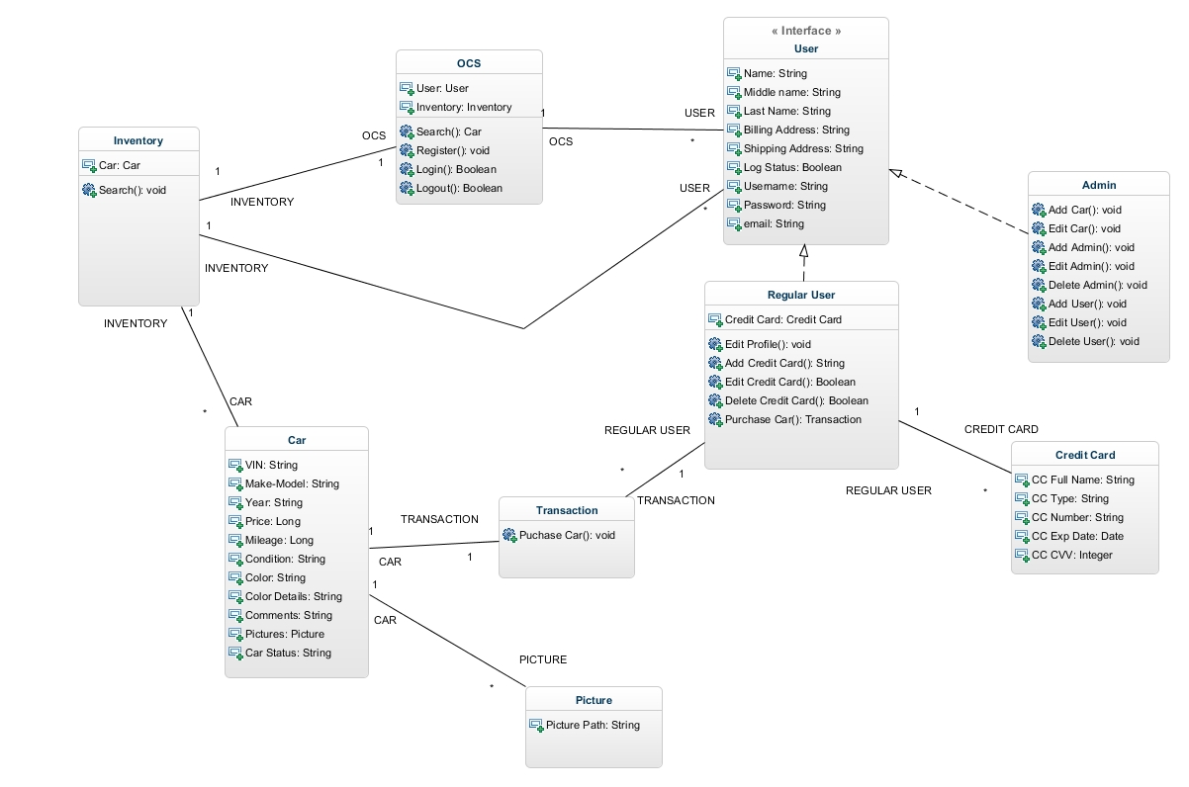
Class Diagrams

Slide 12
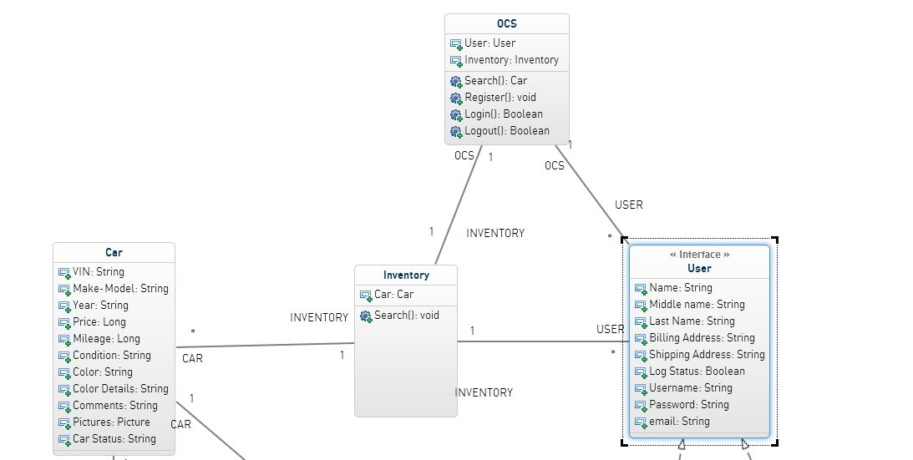
Class Diagrams

Slide 13
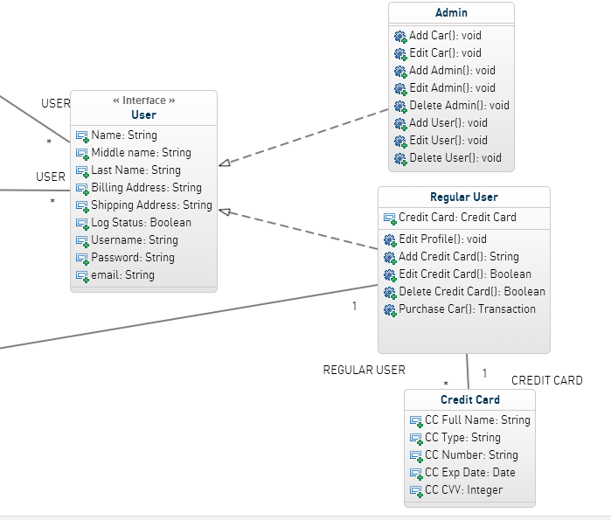
Class Diagrams

Slide 14
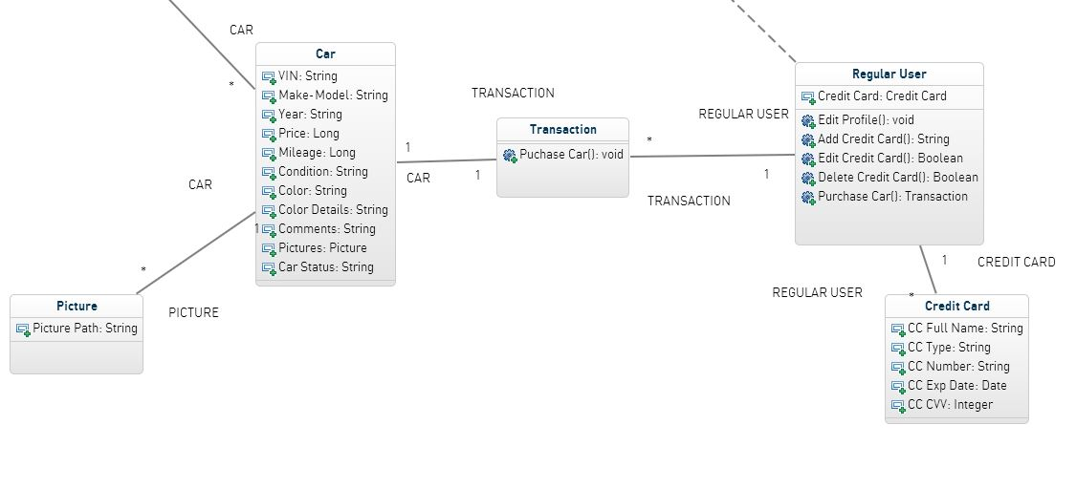
Class Diagrams

Slide 15
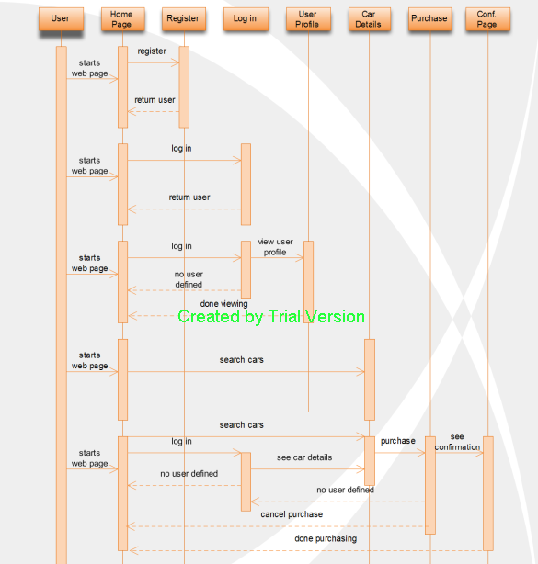
Selected Sequence Diagram 1

Slide 16
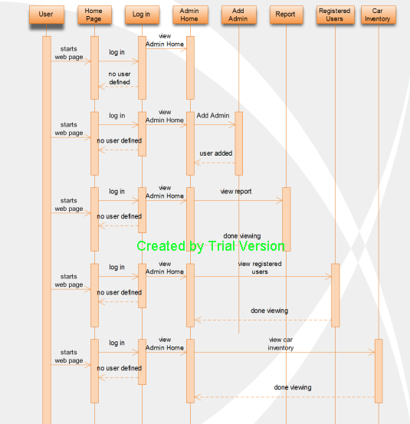
Selected Sequence Diagram 2

Slide 17
Summary
Provide a tool for SOCD to stay competitive
Functional and Non-Functional requirements
Examples of Uses Cases
Constrains
Object Model
Dynamic Model
Questions?

